Slide 1

Learning Objective
I will factorise monic quadratic expressions with negatives.
Enter quietly, please be ready with the following on your desk:
Whiteboard
Whiteboard marker
Exercise Book
Pencil, pen, ruler and red pen
Diary
Calculator
Device – charged or borrowed from Library before maths

Slide 2

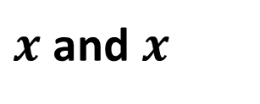








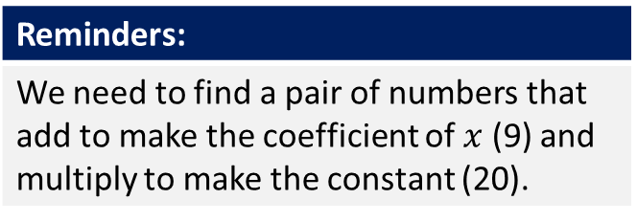
Daily Review
Reminders:
We need to find a pair of numbers that add to make the coefficient of $x$ (9) and multiply to make the constant (20).
$$x^{2}+9x+20$$
$x$ and $x$
What do you multiply together to make $x^{2 }$?
$$x$$
$$5$$
1 and 20
2 and 10
4 and 5
What do you multiply together to make 20?
$$x$$
$$x^{2}$$
$$5x$$
$$4$$
$$4x$$
$$20$$
What do you also add together to make 9?
4 and 5
$$x^{2}+9x+20=(x+4)(x+5)$$

Slide 3






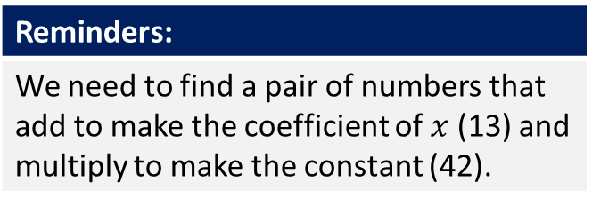
Daily Review
Reminders:
We need to find a pair of numbers that add to make the coefficient of $x$ (13) and multiply to make the constant (42).
$$x^{2}+13x+42$$
$x$ and $x$
What do you multiply together to make $x^{2 }$?
$$x$$
$$6$$
1 and 42
2 and 21
3 and 14
6 and 7
What do you multiply together to make 42?
$$x$$
$$x^{2}$$
$$6x$$
$$7$$
$$7x$$
$$42$$
What do you also add together to make 13?
6 and 7
$$x^{2}+13x+42=(x+6)(x+7)$$

Slide 4






Daily Review
Reminders:
We need to find a pair of numbers that add to make the coefficient of $x$ (12) and multiply to make the constant (20).
$$x^{2}+12x+20$$
$x$ and $x$
What do you multiply together to make $x^{2 }$?
$$x$$
$$10$$
1 and 20
2 and 10
4 and 5
What do you multiply together to make 20?
$$x$$
$$x^{2}$$
$$10x$$
2 and 10
$$2$$
$$2x$$
$$20$$
What do you also add together to make 12?
$$x^{2}+12x+20=(x+2)(x+10)$$

Slide 5
Learning Objective
CFU 1
What will we learn?
I will factorise monic quadratic expressions.
CFU 2
What will we learn?
CFU 3
How will we know if we’ve been successful?
Success Criteria
CFU 4
How will we know if we’ve been successful?
I will be able to:
Find factors of a number.
Factorise monic quadratic expressions.

Slide 6
Activate Prior Knowledge
CFU
What sign will the answer be if the two signs are different?
When multiplying or dividing:
If two numbers have the same sign, then the answer will be positive.
If two numbers have different signs, then the answer will be negative.
CFU
What sign will the answer be if the two signs are the same?
1. (-10) x (+2)
2. (+18) ÷ (+6)
3. (+6) x (-9)
-20
+3
-54
4. (-27) ÷ (-3)
5. (+7) x (-7)
6. (-56) ÷ (+7)
+9
-49
-8

Slide 7







Concept Development
Expanding is the process where you remove the brackets.
Factorising is the reverse - you are putting the brackets in.
$$t^{2}−10t+21$$
$$t$$
We are looking for two numbers that multiply together to make 21.
1 and 21
3 and 7
$$t$$
$$t^{2}$$
$$?t$$
We are also looking for two numbers that add together to make -10.
1 + 21 = 22
3 + 7 = 10
$$?t$$
$$21$$
Neither of these options work!
(But 3 and 7 work better)

Slide 8
Concept Development
Expanding is the process where you remove the brackets.
Factorising is the reverse - you are putting the brackets in.
$$t^{2}−10t+21$$
$$t$$
We are looking for two numbers that multiply together to make 21.
3 and 7
$$t$$
$$t^{2}$$
$$?t$$
If two numbers add together to make
-10, at least one of them must be negative.
$$?t$$
$$21$$
If the two numbers also multiply to give a positive number, they must both be negative as:
Negative x negative = positive
-3 x -7 = 21
-3 + -7 = -10

Slide 9


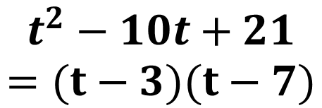


Concept Development
Expanding is the process where you remove the brackets.
Factorising is the reverse - you are putting the brackets in.
$$t^{2}−10t+21$$
$$t$$
$$−3$$
We are looking for two numbers that multiply together to make 21.
3 and 7
$$t$$
$$t^{2}$$
$$−3t$$
If two numbers add together to make
-10, at least one of them must be negative.
$$−7$$
$$−7t$$
$$21$$
If the two numbers also multiply to give a positive number, they must both be negative as:
Negative x negative = positive
-3 x -7 = 21
-3 + -7 = -10
$$t^{2}−10t+21$$
$$=(t−3)(t−7)$$

Slide 10






Guided Practice
Reminders
If the constant is positive, the numbers must have the same sign. If the constant is negative, the numbers must have different signs.
$$x^{2}−8x+15$$
$x$ and $x$
What do you multiply together to make $x^{2 }$?
$$x$$
$$−3$$
1 and 15
3 and 5
What do you multiply together to make 15?
$$x$$
$$x^{2}$$
$$−3x$$
-3 and -5
$$−5$$
$$−5x$$
$$15$$
What do you add together to make -8?
-3 x -5 = 15
-3 + -5 = -8
$$x^{2}−8x+15=(x−3)(x−5)$$

Slide 11






Guided Practice
Reminders
If the constant is positive, the numbers must have the same sign. If the constant is negative, the numbers must have different signs.
$$x^{2}−11x+18$$
$x$ and $x$
What do you multiply together to make $x^{2 }$?
$$x$$
$$−2$$
1 and 18
2 and 9
3 and 6
What do you multiply together to make 18?
$$x$$
$$x^{2}$$
$$−2x$$
-2 and -9
$$−9$$
$$−9x$$
$$18$$
What do you add together to make -11?
-2 x -9 = 18
-2 + -9 = -11
$$x^{2}−11x+18=(x−2)(x−9)$$

Slide 12




Guided Practice
Reminders
If the constant is positive, the numbers must have the same sign. If the constant is negative, the numbers must have different signs.
$$x^{2}−7x−18$$
$x$ and $x$
What do you multiply together to make $x^{2 }$?
$$x$$
$$2$$
1 and 18
2 and 9
3 and 6
What do you multiply together to make 18?
$$x$$
$$x^{2}$$
$$2x$$
2 and -9
$$−9$$
$$−9x$$
$$−18$$
What do you add together to make -7?
2 x -9 = -18
2 + -9 = -7
$$x^{2}−7x−18=(x+2)(x−9)$$

Slide 13




Guided Practice
Reminders
If the constant is positive, the numbers must have the same sign. If the constant is negative, the numbers must have different signs.
$$x^{2}+3x−10$$
$x$ and $x$
What do you multiply together to make $x^{2 }$?
$$x$$
$$−2$$
1 and 10
2 and 5
What do you multiply together to make 18?
$$x$$
$$x^{2}$$
$$−2x$$
-2 and 5
$$5$$
$$5x$$
$$−10$$
What do you add together to make 3?
-2 x 5 = -10
-2 + 5 = 3
$$x^{2}+3x−10=(x−2)(x+5)$$

Slide 14
Independent Practice
Pearson 10 Exercise 3.5 page 184 Question 2
Mathspace – Year 10 Mainstream PPT 59a Factorising Monic Quadratics CLASSWORK

